Slide 1




Overview of single top results from the LHC
Rebeca Gonzalez Suarez (University of Nebraska, Lincoln)

Slide 2
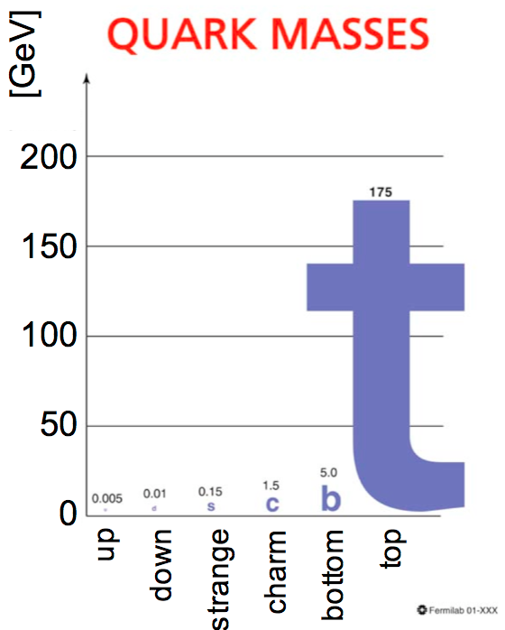

The top quark
It is the heaviest elementary particle known
large coupling to the Higgs boson
candidate to play a special role in the EW symmetry breaking and in many scenarios of physics beyond the SM (BSM)
It decays before hadronizing
direct access to spin, charge and polarization
Discovered by the Tevatron experiments in February 1995 (first collisions on November 30, 1986)
At the LHC: top quarks produced at a much higher rate
PRL 74, 2626–2631, PRL 74, 2632–2637
http://arxiv.org/abs/1009.4935
x-sec (pb) | ttbar
Tevatron | 7.08 (+0.00-0.24) (+0.36-0.27) approx. NNLO
LHC @ 7TeV | 163 (+7-5)(±9) approx. NNLO
LHC @ 8TeV | 234 (+10-7)(±12) approx. NNLO
http://arxiv.org/abs/1210.7813v2
Top factory!

Slide 3
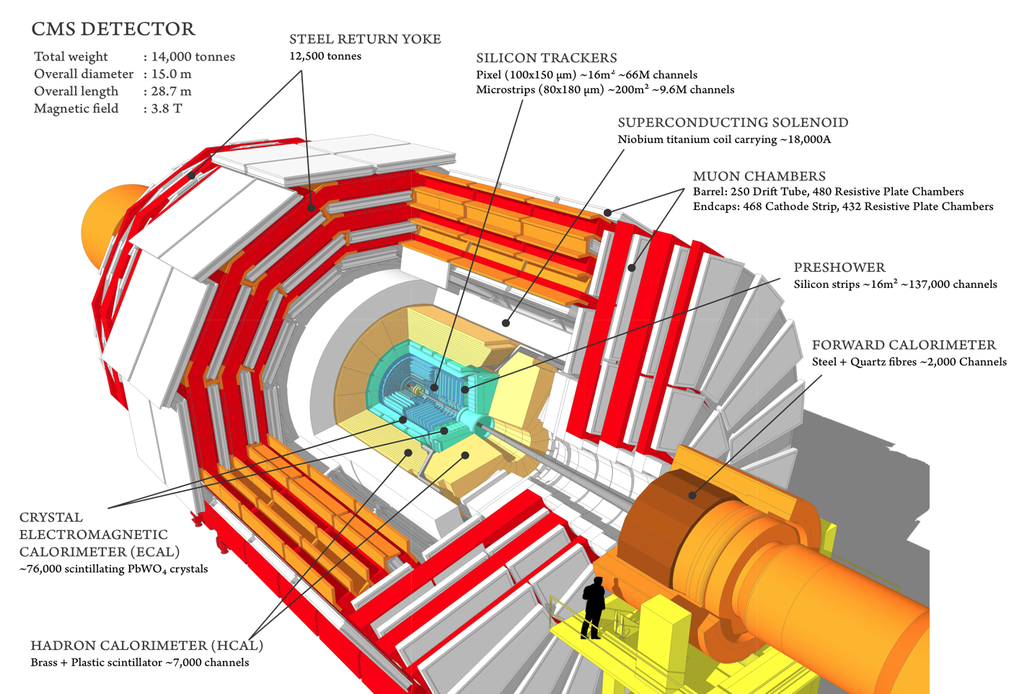
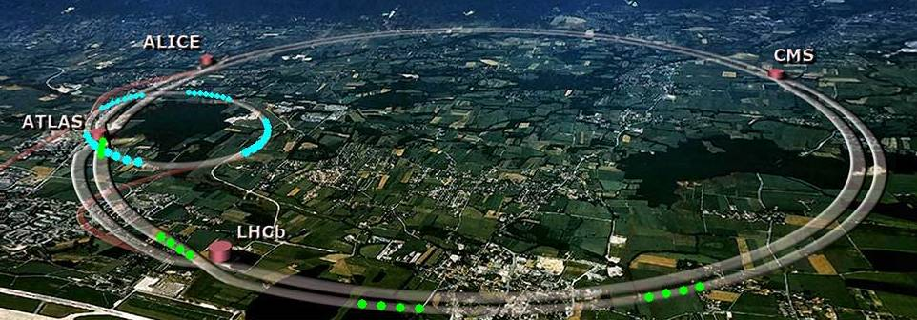
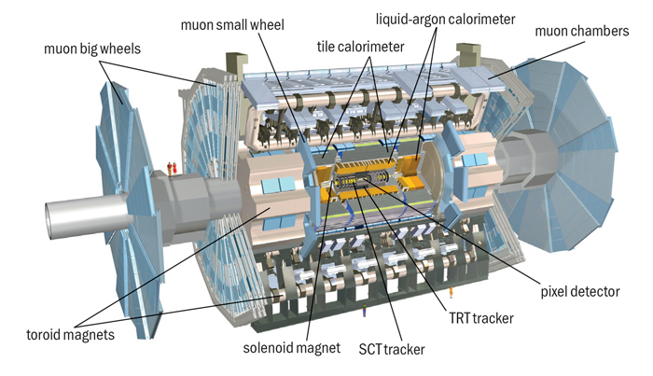
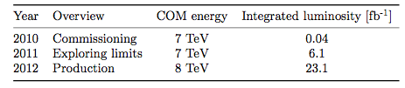
LHC experiments: ATLAS & CMS
Compact Muon Solenoid (CMS)
Total weight : 14,000 tonnes
Overall diameter : 15,0 m
Overall length : 28,7 m
Magnetic Field : 3.8 T
More than 2,600 people, 41 countries
A Toroidal LHC Apparatus (ATLAS)
Total weight: 7000 tonnes
Overall diameter: 25 m
Overall Length: 46 m
Magnetic Field: 2T solenoid + toroids
3000 authors, 38 countries
In top physics the LHC experiments were almost immediately competitive with respect to the Tevatron results (the Tevatron legacy is still important)

Slide 4
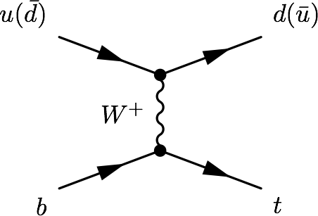
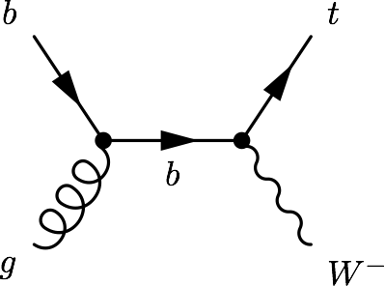
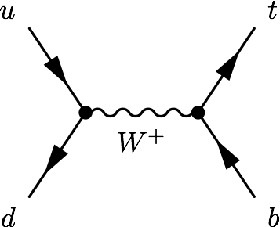
Single top production
At hadron colliders top quarks produced mostly in pairs via strong interaction
Single top quark production: alternative mode (at a much lower rate) via electroweak interaction, involving a Wtb vertex
Three main process contribute:
t-channel, tW associated production, s-channel
Single top processes are sensitive to many models of new physics
FCNC, Anomalous couplings
New particles (W’, charged Higgs)
Provide a characteristic scenario in which to perform SM measurements:
Top polarization, W helicity, top mass, |V_{tb}|
Are a background to searches (Higgs, SUSY)
Just observed
Observed
Work in progress

Slide 5

Single top historically
1986
Tevatron starts colliding
Single top quarks were first observed at the Tevatron (March 2009)
t-channel and s-channel were studied at the Tevatron, tW associated production was not accessible
ATLAS and CMS presented their first t-channel studies with 7TeV data early 2011
Since then, all the main modes have been studied, the t-channel has been used to measure SM properties, and several single top related signatures have been used to study new physics
PRL103:092002, PRL.103:092001
1995
Top quark discovery
CMS-PAS-TOP-11-021, ATLAS-CONF-2011-088
σ [pb] | t-channel | tW | s-channel
Tevatron (1.96 TeV) | 2.26 (±0.12) | 0.28 (±0.06) | 1.04 (±0.08)
LHC (7 TeV) | 65.9 (+2.1-0.7) (+1.5-1.7) | 15.6 (±0.4) (±1.1) | 4.56 (±0.07) (+0.18-0.17)
LHC (8 TeV) | 87.2 (+2.8 -1.0) (+2.0 -2.2) | 22.2 (±0.6) (±1.4) | 5.55 (±0.08) (±0.21)
Established
Not accesible
Evidence
2009
Single top discovery
2010
LHC starts colliding
2011
First single top results at the LHC
JHEP 0809:127,2008
http://arxiv.org/abs/1210.7813v2

Slide 6
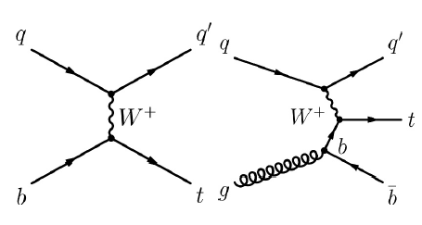
t-channel
Dominating process with the highest cross section at the Tevatron and the LHC
ATLAS and CMS have studied the process and measured its cross-section at 7 and 8 TeV
The final state studied is a lepton + jets signature
Signal events are characterized by:
One isolated muon or electron
Missing transverse energy (MET)
A central b jet
A light-quark jet from the hard scattering process (often forward)
Additionally, a second b jet produced in association to the top quark can be present as well (softer p_{T} spectrum with respect to the b jet from top decay)
Main backgrounds: W+jets, top pairs, multijet
Leptonic top decay

Slide 7
t-channel at √s = 7 TeV
Phys.Lett.B 717(2012) 330-350
JHEP12(2012) 035
Objects (ATLAS/CMS):
Muons: p_{T} > 25/20 GeV, |η| < 2.5/2.1
Electrons: E_{T}/p_{T} > 25/30 GeV, |η| < 2.47/2.5
Jets: Anti-k_{t} (0.4/0.5) p_{T} > 25/30 GeV, |η| < 4.5
+ b-tagging
Event Selection:
Exactly 1 isolated lepton (µ or e)
At least 2 jets (ATLAS: exactly 2 or 3. CMS: several exclusive regions up to 4 jets)
Kinematic cuts:
ATLAS:
MET > 25 GeV; m_{T} (W) > (60 – MET)
CMS:
m_{T} (W) > 40 GeV (µ) ; MET > 25 GeV (e)
ATLAS: NN (+cut-based)
L = 1.04 fb⁻¹
CMS: NN, BDT, |η_{j’}| fit
L =1.17 (µ) / 1.56(e) fb⁻¹
CMS regions:
NN and BDT: 2jets1tag, 3jets1tag
(+ 4j1t, 2j2t, 3j2t, 4j2t to constrain nuisance parameters)
|η_{j’}|: 2j1t divided into:
SR (130 < m_{lνb} < 220 GeV) and SB
ATLAS: exactly 2/3 jets:
b-tagged sample (1 tag)
Pre-tagged sample
2/3jets 1tag: signal region
2/3jets 0tags: W+jets enriched
3jets 2tag, 4jets 0/1/2ttags: ttbar enriched

Slide 8
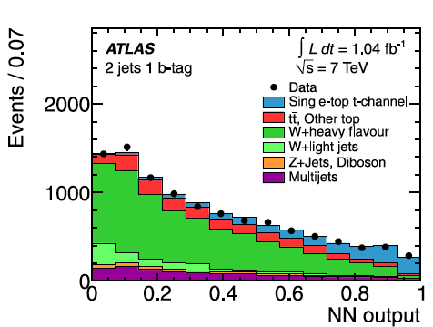
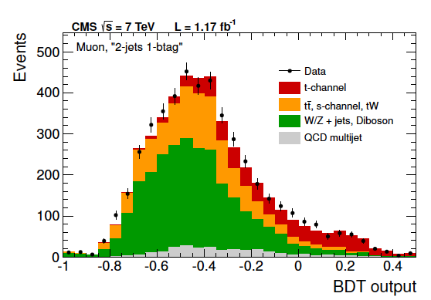
t-channel at √s = 7 TeV: Analysis
Phys.Lett.B 717(2012) 330-350
JHEP12(2012) 035
Background estimation:
QCD multijet: data-driven. Maximum likelihood fit to MET or m_{T}(W) (CMS µ channel). Templates from data: inverting isolation (CMS, µ), failing some conditions (CMS e), replacing the electron requirement by a jet requirement (jet-electron model, ATLAS)
W+jets: ATLAS distributions from MC, normalization from data. CMS checked in CR, estimated from SB to SR in |η_{j’}|
ATLAS:
NN: 12 variables (2 jet), 18 variables (3jet), most discriminant: m_{lbν}, m_{j1j2}
Cut-based: 5 variables (also used by the NN)
CMS:
NN: 37 variables (µ), 38 variables (e), |η_{j’}| highest rank
BDT: 11 variables
|η_{j’}| fit in the SR

Slide 9
t-channel at √s = 7 TeV: Results
Phys.Lett.B 717(2012) 330-350
JHEP12(2012) 035
ATLAS:
Maximum likelihood fit to the NN output
Cut-based: 4 channels (l⁺/l⁻, 2/3 jets treated separately)
Main systematics: ISR/FSR, b-tagging
Results:
NN: σ_{t-channel} = 83±4(stat) +20-19(syst) pb = 83 ± 20 pb
Cut-based: σ_{t-channel} = 92+29-26 pb
|V_{tb}| = 1.13+0.14-0.13, constrained (|V_{tb}| ≤ 1) |V_{tb}| > 0.75 at 95%CL
CMS:
Main systematics: b-tagging, background estimation, generators
|η_{j’}|: σ_{t-channel} = 70.0±6.0(stat)±6.5(syst)±3.6(th)±1.5(lumi) pb
NN: σ_{t-channel} = 68.1±4.1(stat)±3.4(syst)+3.3-4.3(th)±1.5(lumi) pb
BDT: σ_{t-channel} = 66.6±4.0(stat)±3.3(syst)+3.9-3.3(th)±1.5(lumi) pb
Combination:
σ_{t-channel} = 67.2±3.7(stat)±3.0(syst)±3.5(th)±1.5(lumi) pb = 67.2±6.1 pb
|V_{tb}| = 1.020 ± 0.046 ± 0.017, constrained |V_{tb}| > 0.92 at 95% CL
SM expectation
σ_{t-channel} = 65.9 (+2.1-0.7) (+1.5-1.7) pb
http://arxiv.org/abs/1210.7813v2

Slide 10
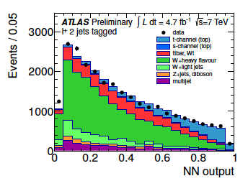
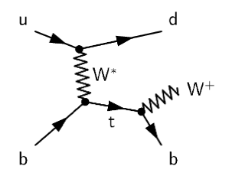
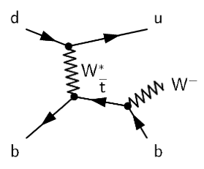
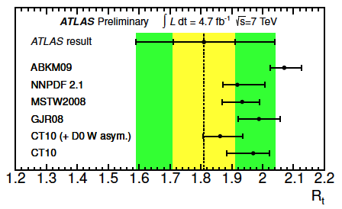
t-channel at √s = 7 TeV: Charge ratio
ATLAS-CONF-2012-056
ATLAS, L = 4.71fb⁻¹
Similar strategy, slightly different cuts:
MET > 30 GeV, m_{T}(W) > 30 GeV
p_{T} cut for (forward) jets > 30 GeV (50 GeV)
Background estimation:
Multijet: same method. W+jets: simulation,
fractions scaled from data
Analysis:
NN: 15 variables 2j1t, 19 variables 3j1t
training done in 4 channels (2 regions, l⁺ or l⁻)
Main systematics: ISR/FSR, multijet normalization
Results:
Maximum likelihood fit to the NN output, l⁺/l⁻ independently:
σ_{top} = 53.2±1.7(stat)±10.6(syst) pb = 53.2±10.8 pb
σ_{anti-top}= 29.5±1.5(stat)±7.3(syst) pb = 29.5+7.4-7.5 pb
R = 1.81±0.10(stat)+0.21-0.20(syst) = 1.81+0.23-0.22
SM expectation
σ_{top}= 43.0 (+1.6-0.2) ±0.8 pb σ_{anti-top}= 22.9±0.5 (+0.7-0.9) pb
http://arxiv.org/abs/1210.7813v2

Slide 11
t-channel at √s = 8 TeV
ATLAS-CONF-2012-132
CMS-PAS-TOP-12-011
Objects (ATLAS/CMS):
Muons: p_{T} > 25/26 GeV, |η| < 2.5/2.1
Electrons: E_{T} > 25 GeV, |η| < 2.47
Jets: Anti-k_{t} (0.4/0.5) p_{T} > 30/60 GeV, |η| < 4.5 + b-tagging
Event Selection:
Exactly 1 isolated lepton
At least 2 jets
(ATLAS: exactly 2/3, CMS: several regions)
Kinematic cuts:
ATLAS: MET > 30 GeV, m_{T}(W) > 50 GeV
CMS: m_{T} (W) > 50 GeV
ATLAS: NN
L = 5.8 fb⁻¹
CMS: |η_{j’}| muon channel
L =5.0 fb⁻¹
ATLAS
Signal region: 1 tag
Control regions: loose b-tagging requirements, vetoing b-tagged events from signal region
CMS
2j1t divided into:
SR (130 < m_{lνb} < 220 GeV) and SB
+Several jet-tag regions as CR to check input variables

Slide 12
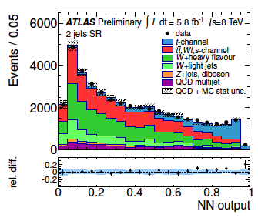
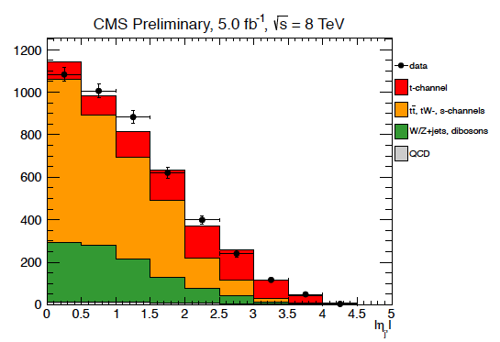
t-channel at √s = 8 TeV: Analysis
ATLAS-CONF-2012-132
CMS-PAS-TOP-12-011
Background estimation:
QCD multijet: Maximum likelihood fit to MET (ATLAS) or m_{T}(W) (CMS) before cut. Template from data, inverting isolation (CMS). Template from PYTHIA jet-electron model (ATLAS)
W+jets: ATLAS simulation, fractions scaled from data. CMS from SB to SR
tt: CMS normalization from simulation, template from 3j2t
CMS:
Fit to |η_{j’}| in 2j1t, SR
ATLAS:
NN: 11 variables. Training independently 2j1t and 3j1t

Slide 13
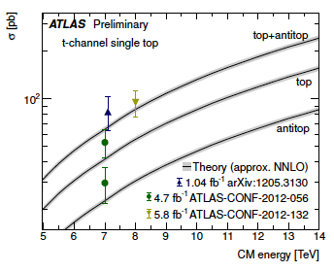
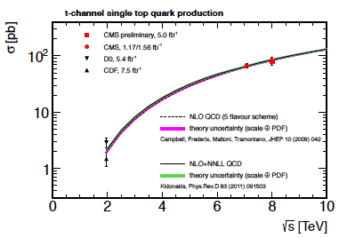
t-channel at √s = 8 TeV: Results
ATLAS-CONF-2012-132
CMS-PAS-TOP-12-011
ATLAS
Binned maximum likelihood fit to the NN in 2/3 jets samples
Main systematics: ISR/FSR, b-tag
σ_{t-channel} = 95.1±2.4(stat)±18.0(syst) pb= 95.1±18.1 pb
|V_{tb}| = 1.04+0.10-0.11, constrained |V_{tb}| > 0.80 at 95%CL
CMS
Maximum likelihood fit to |η_{j’}| in 2j1t in the SR
Larger systematic effect: JES
σ_{t-channel} = 80.1±5.7(stat)±11.0(syst)±4.0(lumi) pb
|V_{tb}|= 0.96±0.08(exp)±0.02(th)
constrained |V_{tb}| > 0.81 at 95%CL
SM expectation
σ_{t-channel} = 87.2 (+2.8-1.0) (+2.0-2.2) pb
http://arxiv.org/abs/1210.7813v2

Slide 14
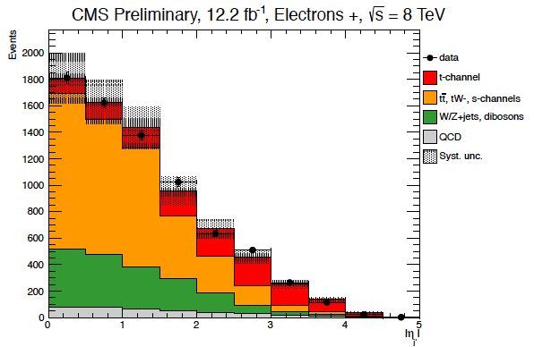
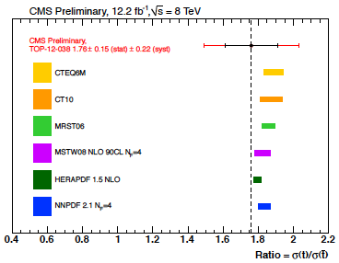
t-channel at √s = 8 TeV: Charge ratio
CMS, L = 12.2fb⁻¹
CMS-PAS-TOP-12-038
|η_{j’}| analysis with both muons and electrons
Electrons E_{T} > 30 GeV, |η|<2.5; Jet P_{T} > 40 GeV
Same event selection with MET > 45 GeV for electron channel (instead of m_{T}(W) cut)
Multijet background: same method, fit to MET for electron channel.
Analysis: Fit to |η_{j’}| in 2j1t, SR, for l⁺ and l⁻
Main systematics: pdf, background estimation
SM expectation
σ_{top}= 56.4 (+2.1-0.3) ±1.1 pb
σ_{anti-top}= 30.7±0.7 (+0.9-1.1) pb
http://arxiv.org/abs/1210.7813v2
Results:
σ_{top} = 49.9±1.9(stat)±8.9(syst) pb
σ_{anti-top}= 28.3±2.4(stat)±4.9(syst) pb
R = 1.76±0.15(stat)±0.22(syst)

Slide 15
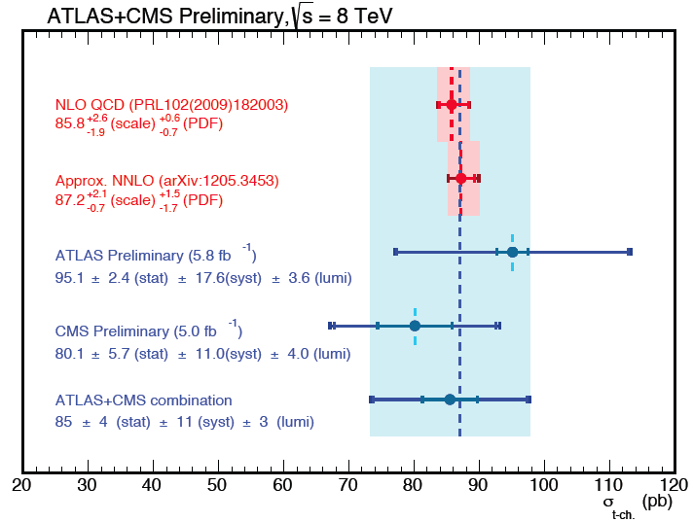
t-channel at √s = 8 TeV: Combination
ATLAS-CONF-2013-098
TOP-12-002
Technique: Iterative BLUE (Best Linear Unbiased Estimator)
Uncertainty contributions separated in categories
Correlation assumptions for the different systematics
Stability of the combination tested varying correlation factors
Systematics with the larger impact: simulation and modeling
SM expectation
σ_{t-channel} = 87.2 (+2.8-1.0) (+2.0-2.2) pb
http://arxiv.org/abs/1210.7813v2
Result: σ_{t-channel} = 85±4(stat)±11(syst)±3(lumi) pb = 85±12 pb

Slide 16
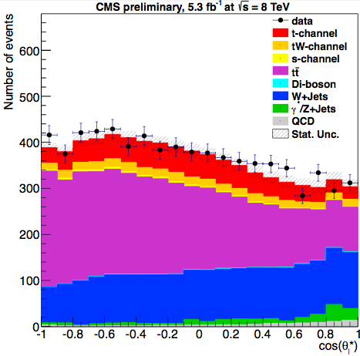
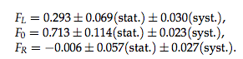
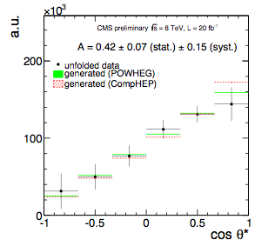
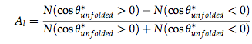
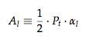
Measurements in t-channel
Concerning t-channel signatures, there is already a dataset collected large enough (both at 7 and 8TeV) to perform SM measurements
Pt
Both are sensitive to anomalous tWb couplings
(µ) L =1.14fb⁻¹(7TeV) and 5.3fb⁻¹(8TeV)
W-helicity fractions [TOP-12-020] (7+8 TeV)
Standard t-channel selection.
F_{L;R;0} extracted from the distribution of cosθ_{l}*. cosθ_{l}* defined in the top-quark rest-frame as the angle between the lepton 3-momenta in the W-boson rest-frame and the 3-momenta of W-boson.
Top polarization [TOP-13-001] 8TeV
top quarks are highly polarized, polarization related to spin asymmetry. Top-quark spin preferably aligned parallel to direction of the (untagged) recoil jet. Polarization measured using the slope of the unfolded distribution of cosθ*_{l}, defined as the angle between the charged lepton and the untagged jet in the reconstructed top quark rest frame.
P_{t} = 0.82±0.12(stat.)±0.32(syst.)=0.82±0.34
BDT, e/µ
L =20fb⁻¹

Slide 17
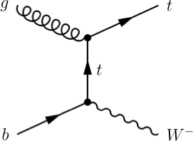
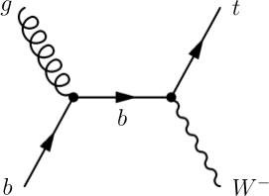
tW associated production
Single top process with the second largest cross-section at the LHC, negligible at the Tevatron
ATLAS and CMS showed evidence at 7 TeV, CMS has presented the first observation at 8TeV
The final state studied is a dilepton signature
Signal events are characterized by:
Two opposite-sign, isolated leptons
Missing transverse energy (2 neutrinos in the final state)
A jet coming from a b decay
Backgrounds: ttbar, DY

Slide 18
tW at √s = 7 TeV [First Evidence]
Phys.Lett.B 716 (2012) 142-159
Phys.Rev.Lett 110, 022003 (2013)
Objects (ATLAS/CMS):
Muons: p_{T} > 25/20 GeV, |η| < 2.5/2.1
Electrons: E_{T}/p_{T} > 25/20 GeV, |η| < 2.47/2.4
Jets: Anti-k_{t} (0.4/0.5) E_{T}/p_{T} > 30 GeV, |η| < 2.5/2.4
b-tagging (CMS)
Event Selection:
Exactly 2 opposite-charge isolated leptons
(µµ, eµ and ee)
ATLAS:
MET > 50 GeV
ee/µµ: veto events with 81 < m_{ll} < 101 GeV
ΔΦ_{(l1, MET)} + ΔΦ_{(l2, MET)} > 2.5 to reduce Z-> ττ
CMS:
m_{ll} > 20 GeV
ee/µµ: veto events with 81 < m_{ll} < 101 GeV
ee/µµ: min (MET, Tracker MET) > 30 GeV
ATLAS: BDT
L = 2.05 fb⁻¹
CMS: BDT (+cut-based)
L = 4.9 fb⁻¹
ATLAS uses events with at least 1 jet (signal region, exactly 1)
CMS
Signal Region: Exactly 1 jet, b-tagged (no additional b-tagged jets, p_{T} > 20)
Control Regions: Exactly 2 jets 1/2 tags (ttbar)

Slide 19
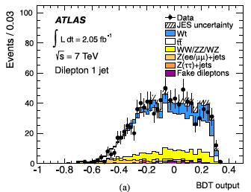
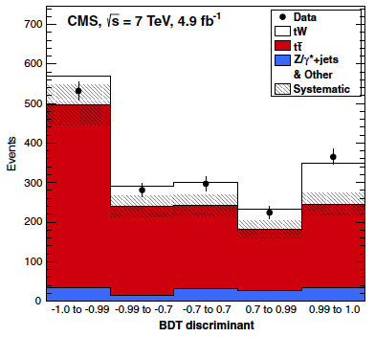
tW at √s = 7 TeV: Analysis
Phys.Lett.B 716 (2012) 142-159
Phys.Rev.Lett 110, 022003 (2013)
Background estimation:
tt: Dedicated control regions included in the fit. ATLAS: events with exactly 2 jets and with 3 or more. CMS: 2jet 1tag and 2jet 2tag regions
DY: data-driven scale factors. ATLAS: from control regions defined by MET and m_{ll} CMS: MET-dependent, from Z mass peak inverting the m_{ll} cut
Fakes: ATLAS matrix method (< 1%)
Z-> ττ: ATLAS control region inverting the cut
ATLAS:
BDT (training on 1jet events), 22 variables. Most powerful: p_{T} of the system (leptons, MET, jet)
CMS:
BDT (4 variables) + cut based (extra cut on eµ H_{T})

Slide 20
tW at √s = 7 TeV: Results
Phys.Lett.B 716 (2012) 142-159
Phys.Rev.Lett 110, 022003 (2013)
ATLAS:
Maximum likelihood fit over BDT distribution in signal and control regions
Main systematics JES, parton shower
Results:
Significance: 3.3σ observed (3.4σ expected)
σ_{tW} = 16.8 ± 2.9 (stat) ± 4.9 (syst) pb
|V_{tb}| = 1.03+0.16-0.19
CMS:
Binned likelihood fit on BDT distributions, separated by final state and regions
Dominating systematic: JES, matching thresholds
Results:
Significance: 4.0σ (3.6+0.8-0.9σ expected)
σ_{tW} =16+5-4 pb
|V_{tb}| = 1.01+0.16-0.13+0.03-0.04(th)
constrained |V_{tb}| > 0.79 at 90% CL
SM expectation
σ_{tW} = 15.6±0.4±1.1 pb
http://arxiv.org/abs/1210.7813v2
Cut-based:
3.5σ (3.2±0.9σ expected)
σ_{tW} =15±5 pb

Slide 21
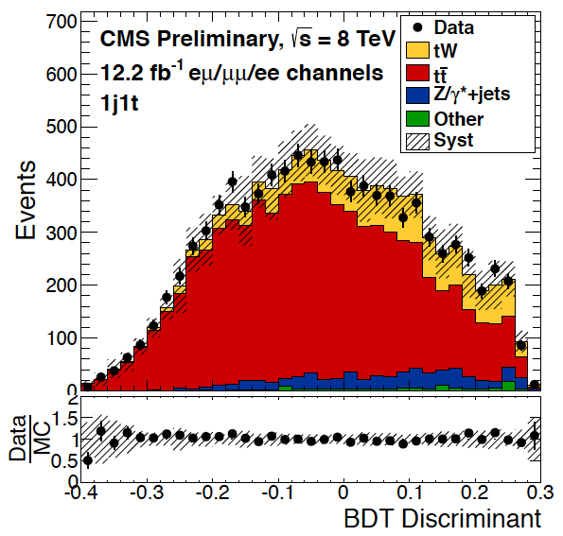
CMS: tW at √s = 8 TeV [Observation]
CMS L = 12.2fb⁻¹
CMS-PAS-TOP-12-040
Objects:
Muons (Electrons)
p_{T}> 20 GeV, |η| < 2.4(2.5), isolated
Jets:
Anti-k_{t} 0.5 p_{T} > 30 GeV, |η| <2.4 corrected
(+ loose jets: failing p_{T}/|η| ; p_{T} > 20 GeV, |η| < 4.9)
b-tagging
Event selection:
Exactly 2 leptons, opposite charge
m_{ll} > 20 GeV
ee/µµ:
veto events with 81 < m_{ll} < 101 GeV
MET > 50 GeV
Analysis
BDT, 13 variables (variables related to loose jets most powerful)
Two cross-check analyses, additional cut in eµ H_{T} > 160: fit on shape of p_{T} of the system and event counting
Same regions and background estimations as in the 7TeV analysis

Slide 22
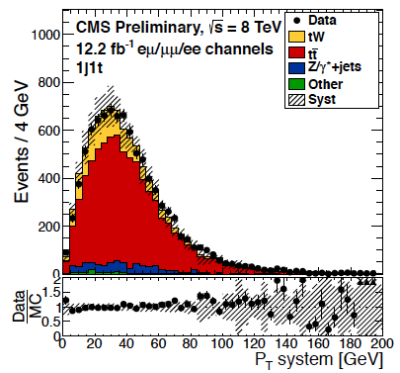
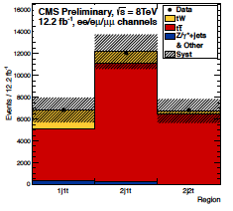
CMS: tW at √s = 8 TeV: Results
CMS-PAS-TOP-12-040
CMS:
Binned likelihood fit on the three final states in the three regions
Main systematics, theoretical: matching thresholds, Q²
Results:
Significance: 6.0σ (5.4+1.5-1.4σ expected)
σ_{tW} = 23.4+5.5-5.4 pb
|V_{tb}| = 1.03 ± 0.12(exp)±0.04(th), constrained |V_{tb}| > 0.78 at 95%CL
SM expectation
σ_{tW} = 22.2±0.6±1.4 pb
http://arxiv.org/abs/1210.7813v2
Cross-check (fit to the p_{T} of the system):
4.0σ (3.2+0.4-0.9σ)
σ_{tW} = 24.3+8.6-8.8 pb
Cross-check (cut based):
3.6σ (2.8+0.9-0.8σ)
σ_{tW} = 33.9+8.6-8.6 pb

Slide 23
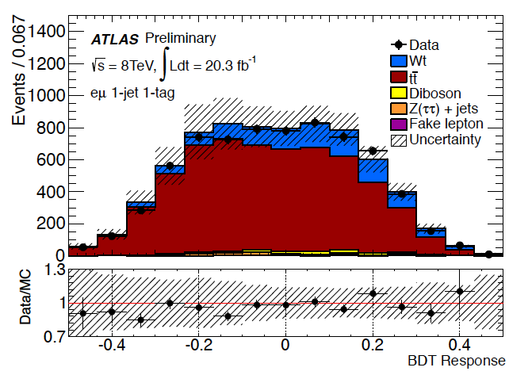
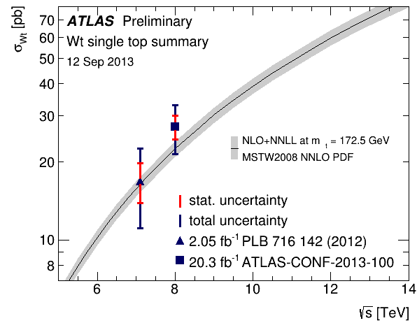
ATLAS: tW at √s = 8 TeV
ATLAS-CONF-2013-100
ATLAS L = 20.3fb⁻¹
eµ channel
Event selection:
eµ pair, opposite charge
Exactly 1/2 jets, at least one b-tagged
Fake leptons background: matrix method
Analysis:
BDT: 19 variables (1 jet), 20 variables (2 jet)
Maximum likelihood fit to the BDT output in both regions
Larger systematics: generators and flavor tagging
Result:
Significance: 4.2σ (4.0σ expected)
σ_{tW} = 27.2±2.8(stat)±5.4(syst) pb
|V_{tb}| = 1.10±0.12(exp)±0.03(th)
constrained |V_{tb}| > 0.72 at 95%CL
SM expectation
σ_{tW} = 22.2±0.6±1.4 pb
http://arxiv.org/abs/1210.7813v2

Slide 24
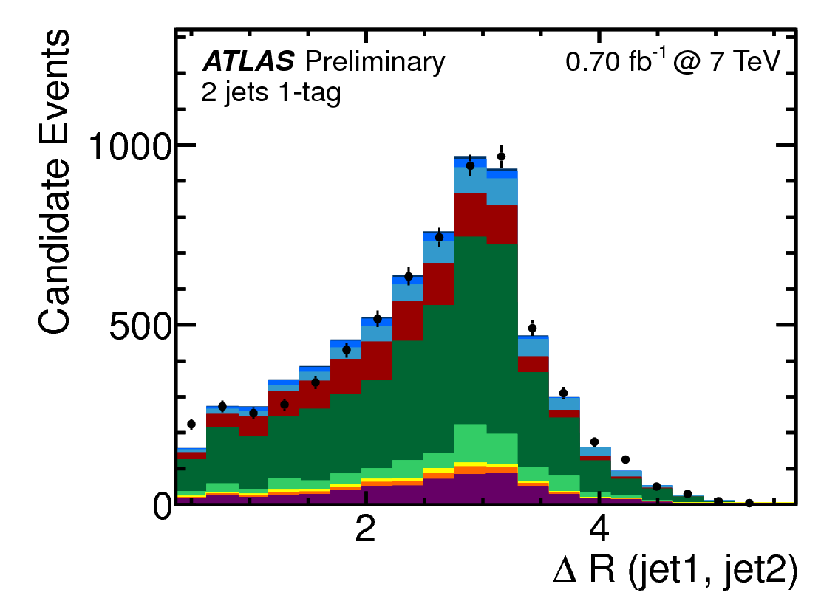
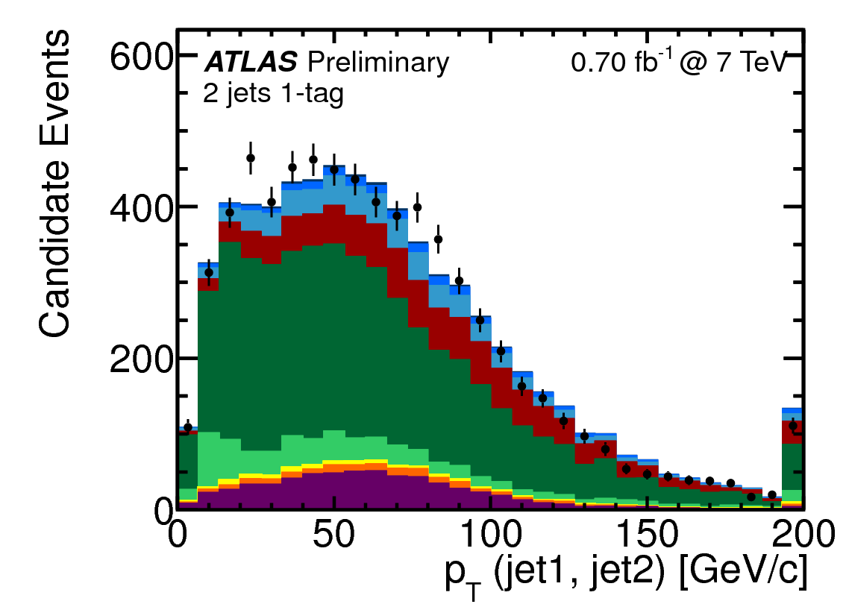
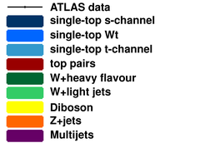
s-channel at √s = 7 TeV
ATLAS-CONF-2011-118
ATLAS, L = 0.70 fb⁻¹
Sensitive to new physics, W’ bosons, charged Higgs bosons
Signal signature: lepton + jets
A lepton (e,µ) and MET from the decay of a W boson
Two jets with high transverse momentum
at least one of which originating from a b-quark
Backgrounds: W+jets and ttbar (same final state), multijet
Cut-based analysis, cuts optimized Vs. S/√B, statistically limited
Same objects, event selection* and background estimation as t-channel 7TeV analysis
(*only central jets are used here)
SM expectation
σ_{s-channel} = 4.56±0.07 (+0.18-0.17)pb
http://arxiv.org/abs/1210.7813v2
Observed (expected) upper limit:
σ_{s-channel} < 26.5 (20.5) pb at 95%CL

Slide 25
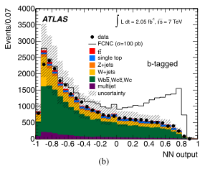
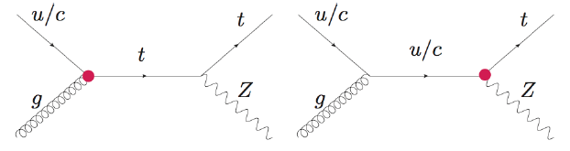
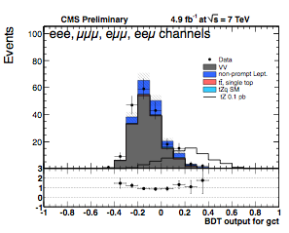
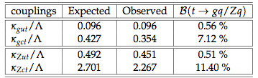
Searches: FCNC
NN, L=2.05fb⁻¹
Search for FCNC in single top events, 7TeV
ATLAS PLB 712, 4-5 (2012) 351–369
qg→t (q = u,c)
l+jets signatures
NN analysis
Limits on the coupling constants and BR
B(t→ug) < 5.7· 10⁻⁵, B(t→cg) < 2.7· 10⁻⁴
CMS TOP-12-021
tZ, production and decay
Trilepton signatures
BDT (gut, gct, Zut, Zct)
Main background from fake leptons (Z+jets): shapes from data, inverting third lepton isolation + low MET.
Limits on couplings and branching fractions
BDT, L=4.9fb⁻¹

Slide 26
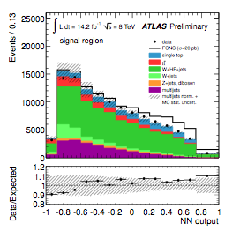
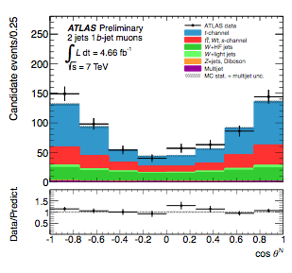
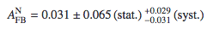
Searches:
NN, L = 14.2fb⁻¹
FCNC at 8TeV
Update on the 7TeV analysis
B(t→ug) < 3.1· 10⁻⁵
B(t→cg) < 1.6· 10⁻⁴
limits improve previous results by ~ a factor of two and are the most stringent to date on FCNC single top-quark production processes for qg→t
ATLAS-CONF-2013-063
L = 4.66fb⁻¹
CP violation on t-channel decays at 7TeV
Studying the forward-backward asymmetry in the plane defined by the W momentum and the top quark polarization. A non-zero value of this asymmetry signals a CP-violating contribution to the Wtb vertex.
ATLAS-CONF-2013-032
Plus more single top-like BSM signatures studied:
W’searches, 4th gen B’, single b*, monotops…

Slide 27
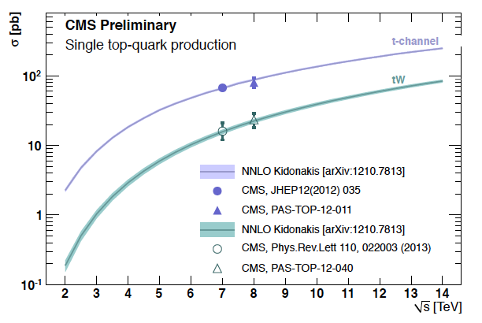
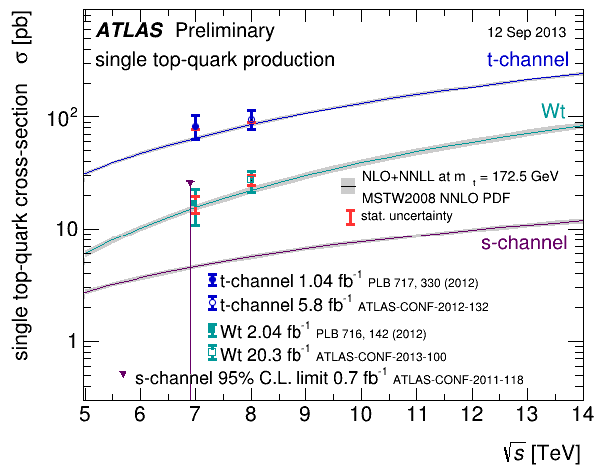
Summary
ATLAS and CMS have a broad catalog of single-top analyses: t-channel and tW studies at 7 and 8TeV, s-channel studies ongoing (challenging final state)
t-channel rediscovered at the LHC with early 7TeV data, cross-section and charge ratio measured at 7 and 8TeV using various techniques
Evidence of the tW associated production reported by both experiments with 7TeV data, process observed by CMS at 8TeV
Work ongoing on the combination of results, first LHC common result:
t-channel combination at 8TeV
So far, everything in agreement with the Standard Model expectations

Slide 28
Backup

Slide 29
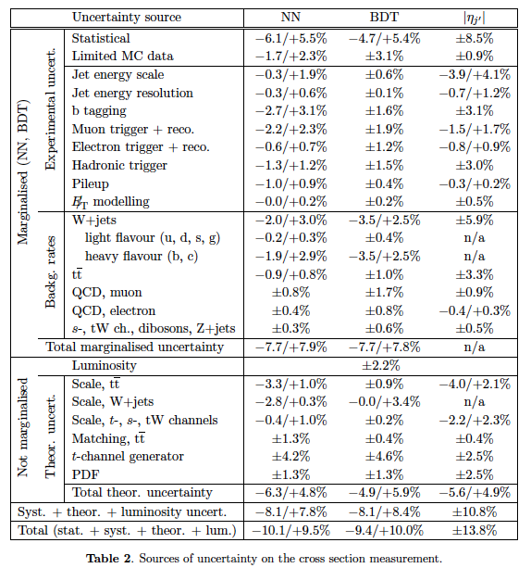
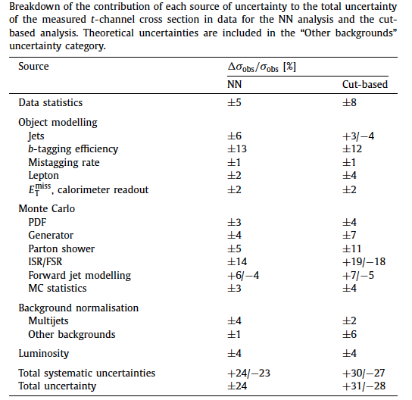
t-channel at √s = 7 TeV: Systematics
Phys.Lett.B 717(2012) 330-350
JHEP12(2012) 035

Slide 30




t-channel at √s = 7 TeV: Results
Phys.Lett.B 717(2012) 330-350
JHEP12(2012) 035
ATLAS
NN
Cut-based
CMS
|ηj’|
NN
BDT

Slide 31


R at √s = 7 TeV: Systematics & Results
ATLAS-CONF-2012-056

Slide 32


t-channel at √s = 8 TeV: Systematics
ATLAS-CONF-2012-132
CMS-PAS-TOP-12-011

Slide 33
t-channel at √s = 8 TeV: Results
ATLAS-CONF-2012-132
CMS-PAS-TOP-12-011

Slide 34


R at √s = 8 TeV: Syst. & Results
CMS-PAS-TOP-12-038

Slide 35


Combination at √s = 8 TeV
ATLAS-CONF-2013-098
REF. coming soon!

Slide 36




tW at √s = 7 TeV
Phys.Lett.B 716 (2012) 142-159
Phys.Rev.Lett 110, 022003 (2013)

Slide 37


tW at √s = 8 TeV
ATLAS-CONF-2013-100
CMS-PAS-TOP-12-040

Slide 38

s-channel at √s = 7 TeV
ATLAS-CONF-2011-118

Slide 39

Tevatron Vs LHC

